Slide 1



Advanced
Analytics
Sales
Project
Alpha
group

Slide 2

​
1. Business Overview
2. Business Objective
3. Advanced Analytics
Agenda
4. Data Science Process
5. Next Steps

Slide 3


A
Alpha Group is one of the leading industry retailers in the region, with more than 50 branches across the region. It runs multiple lines of business applications, mainly in the sport goods industry. They are in the middle of their digital transformation journey and they want to keep leading the market by satisfying their customers and meeting their expectation.
G
Business Overview
Alpha
Group

Slide 4

Business Objective
A
Alpha Group wants to leverage advanced analytics for to increase their sales and boosting marketing campaign.
G
Alpha
Group

Slide 5
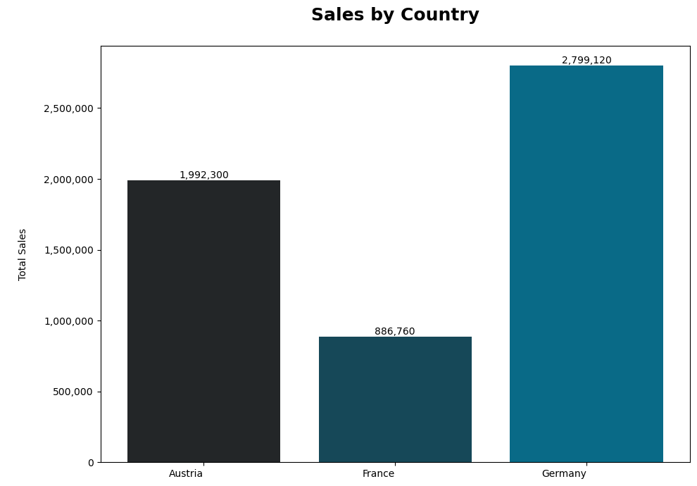
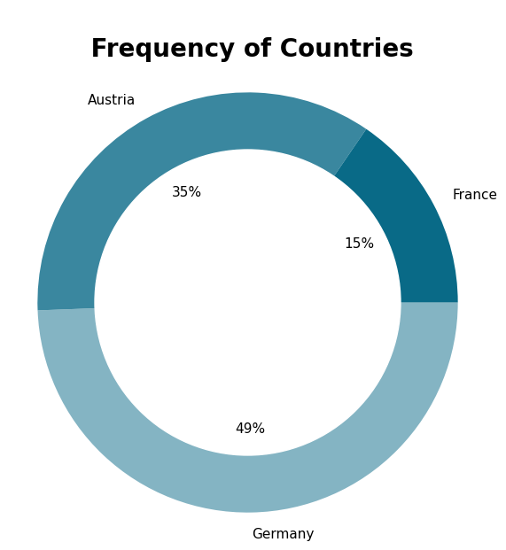
- And accordingly, Germany is the dominant country in total amount of sales, followed by Austria, and France.
ADVANCED ANALYTICS
Germany has the highest frequency with 49% and France has the lowest with 15%

Slide 6
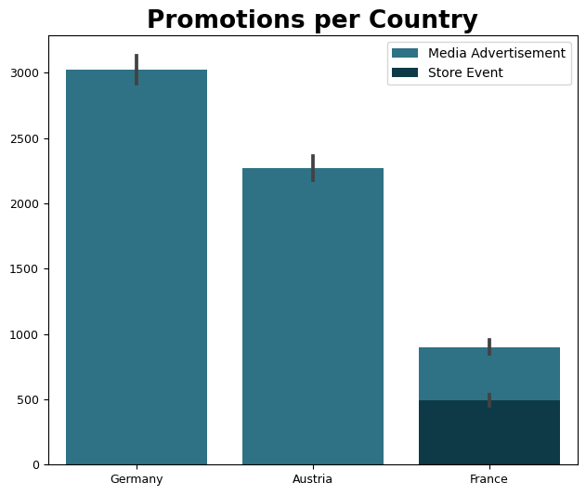

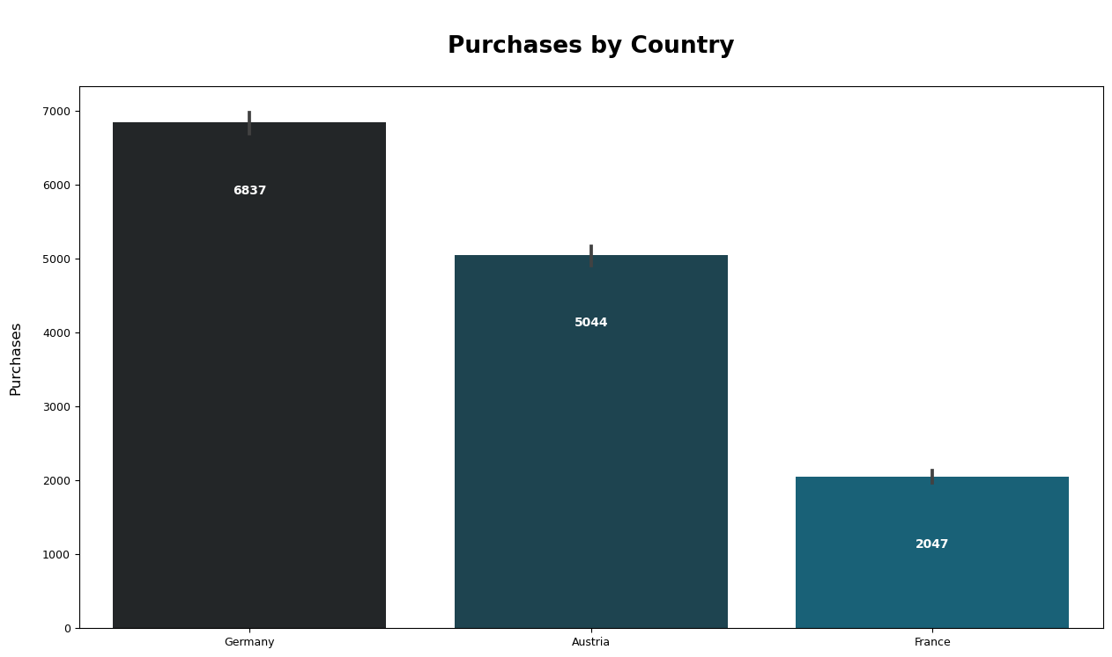
Store Event promotion ‘s been launched in France only
Media Ads promotion ‘s been launched in all countries
Highest numbers of Media Ads promotion’s been launched in Germany
(3020 times), followed
by Austria (2270 times),
and France with lowest
number of times (900)
ADVANCED ANALYTICS
Media Ads promotion has close success rate percentages in all countries but with highest percentage in Austria 22.9%
Store Event success rate seems more effective in France as it's twice the success rate of Media ads promotion there
There is a relationship between promotions and the purchase decision in countries

Slide 7
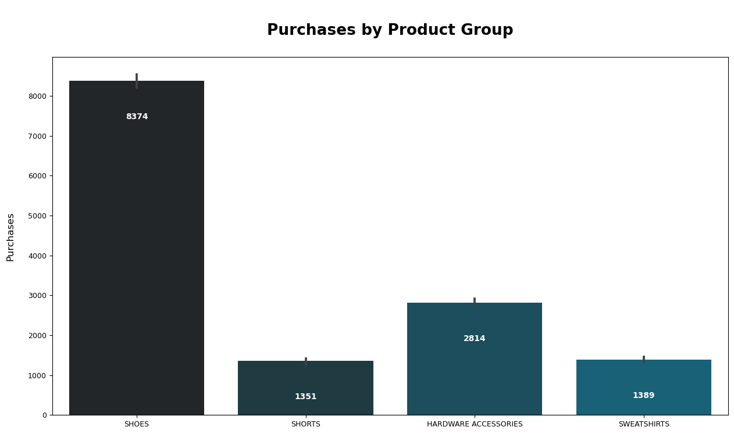
Data looks imbalanced
- Most purchased items by Product: 1- Shoes
2- Hardware Accessories
3- Sweatshirsts
4- Shorts
ADVANCED ANALYTICS

Slide 8
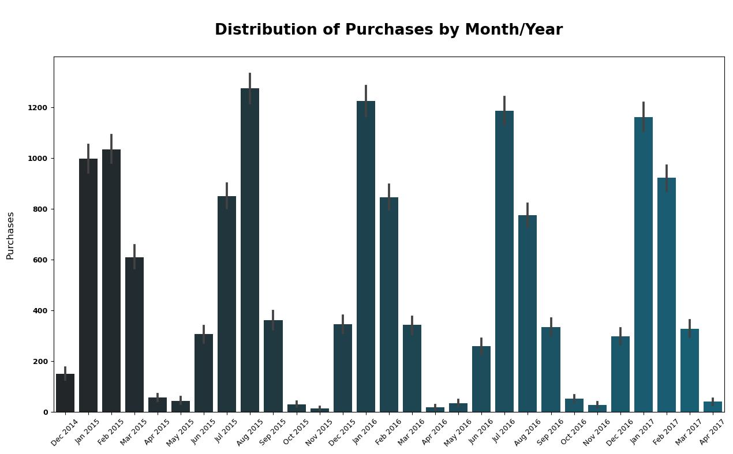
In August 2015, we observed the peak in purchase activity. Conversely, the months with the lowest purchase counts are June, April, May, November, and October
ADVANCED ANALYTICS

Slide 9
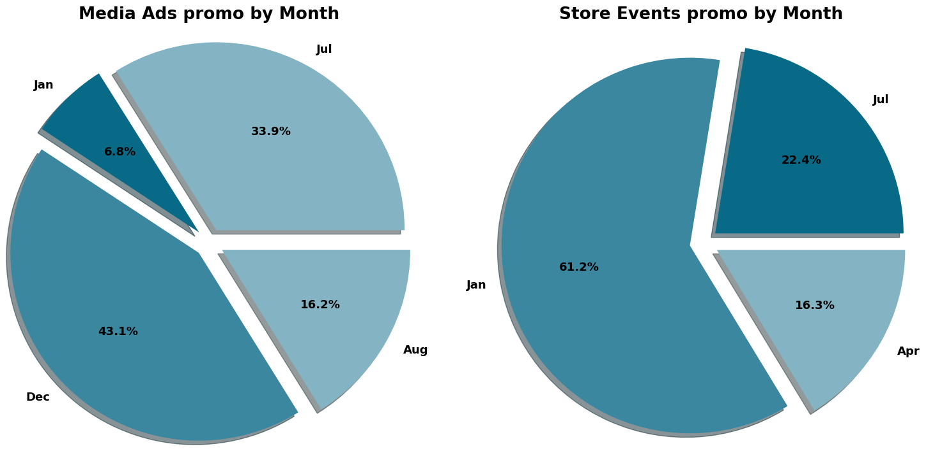
Media advertisements were launched in four months, with December having the highest occurrence at 43.1%, followed by July, August, and January.
Store events were launched in three months, with January having the highest occurrence at 61.2%, followed by July and April.“
There exists a robust correlation between various types of promotional occurrences and the distribution of monthly purchases. Specifically, in June, May, November, and October—months characterized by the lowest purchase counts—no types of promotion are observed, indicating a discernible link between promotional activity and purchasing behavior.
ADVANCED ANALYTICS

Slide 10
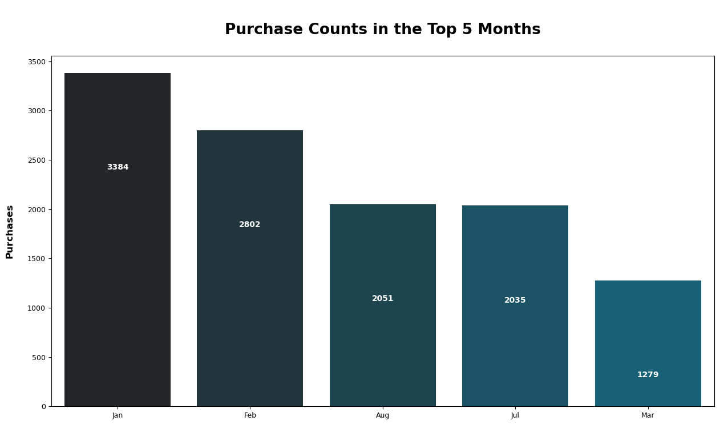
ADVANCED ANALYTICS
Promotions occurring primarily in December, with some continuation into January, lead to increased purchases in both January and February. Additionally, promotions in July and August significantly boost purchases during these months.

Slide 11
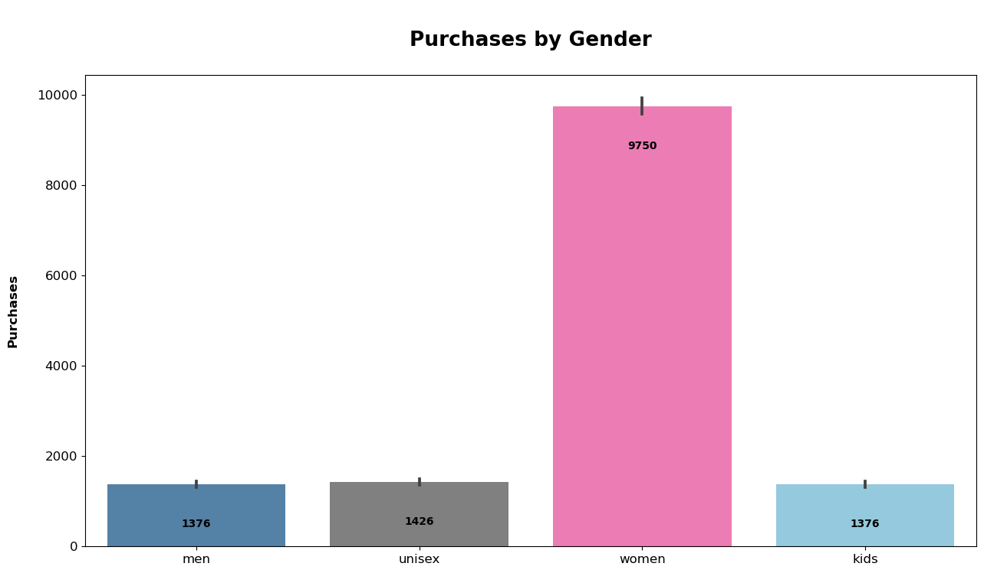

Women having the highest number of purchases in the gender category
the number of purchases made by women is significantly higher than the number made by men, but when considering the percentage of purchases within each gender category, the distribution across different purchase categories is relatively balanced.
ADVANCED ANALYTICS

Slide 12
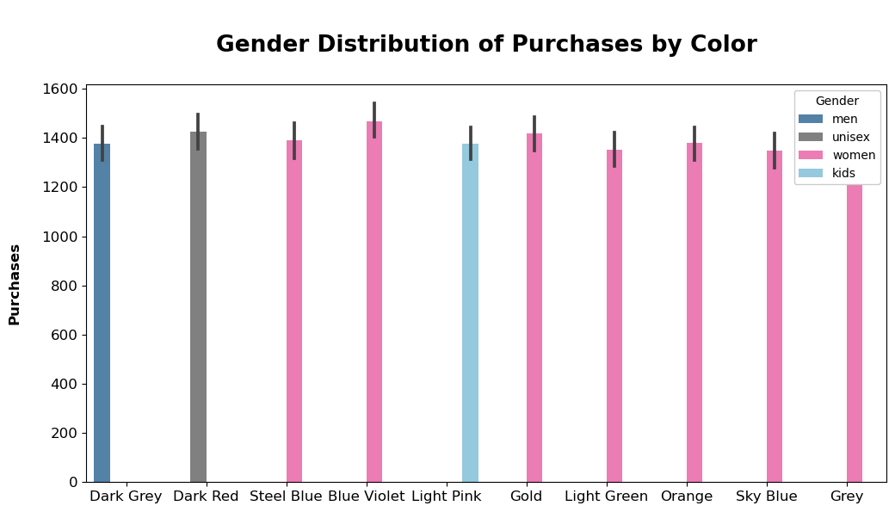
These color preferences all main colors in our data, potentially explaining why women dominate the purchase counts.
In our data, we find that specific colors are traditionally associated with femininity or perceived as "girly." For instance, shades like pink, pastel tones, and certain purples are culturally linked to femininity and tend to appeal more to women. Moreover, marketing tactics often target genders by leveraging colors known to resonate with them, thus influencing purchasing behavior.
ADVANCED ANALYTICS

Slide 13
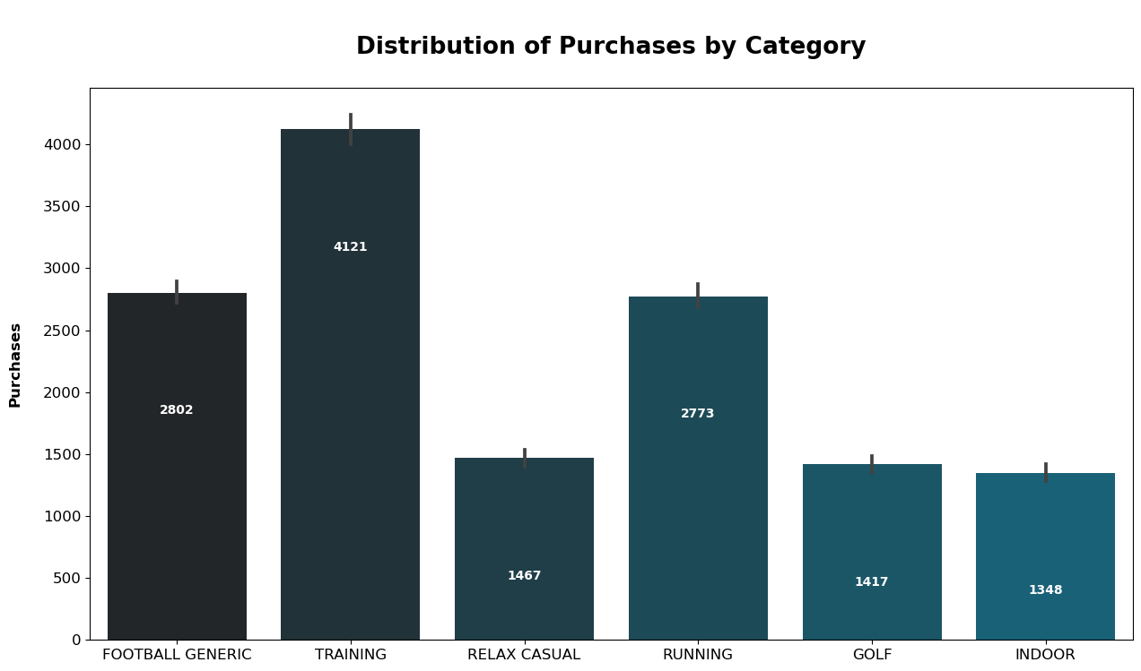
ADVANCED ANALYTICS
- Training category has the highest number of purchases, then Running and Football generic

Slide 14
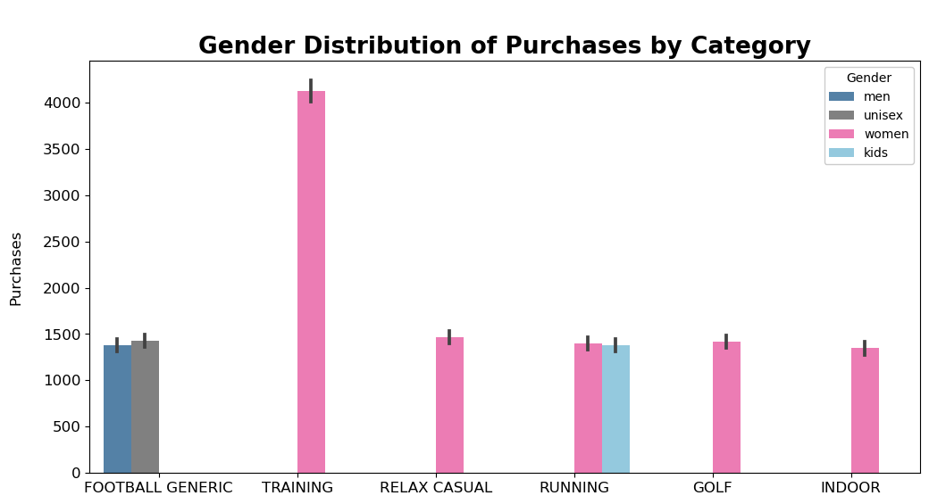
ADVANCED ANALYTICS
- Women are buying a lot more products in categories like "TRAINING," "GOLF," "INDOOR," and "RELAX CASUAL." This shows that these types of products are popular among women. However, there might be a problem because it seems like men and kids aren't buying as much. To fix this, we might need to offer a wider variety of products that appeal to everyone.

Slide 15
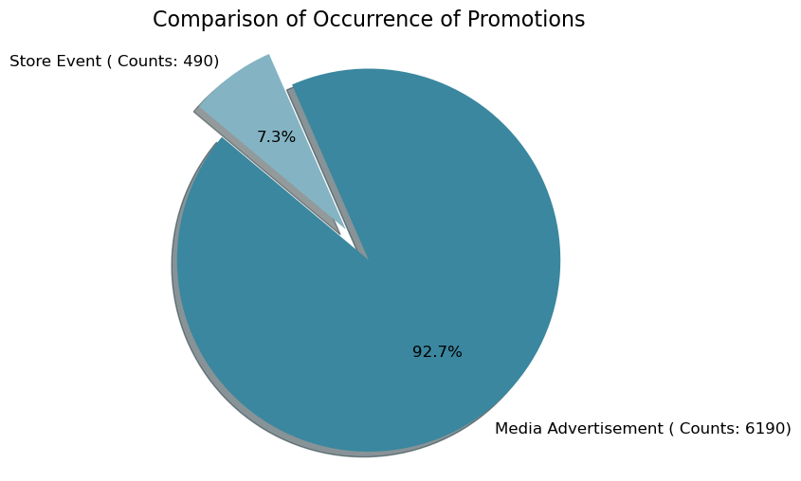
ADVANCED ANALYTICS
- Store events are bringing in more purchases compared to media ads, even though there are more media ads happening than store events.

Slide 16
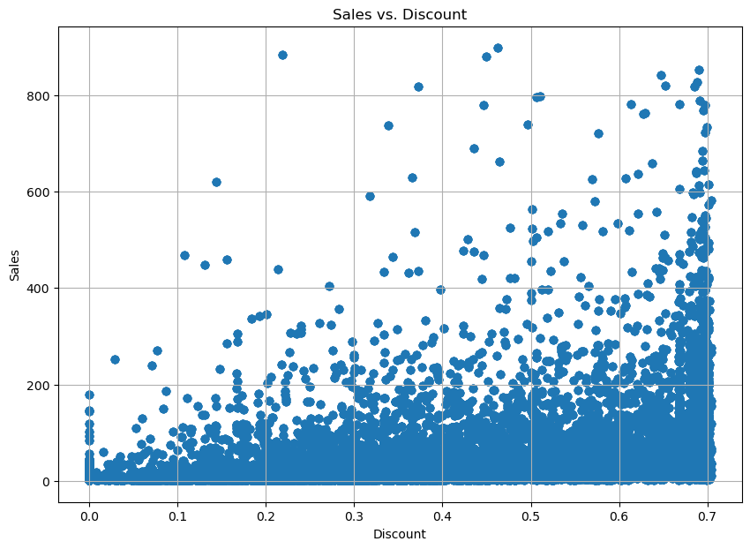
- Higher discounts may lead to increased sales, but this relationship is not strictly linear. Some weeks with higher discounts may not necessarily result in higher sales, and vice versa. Additionally, other factors such as product demand, marketing efforts, and seasonal trends could also influence weekly sales figures.
ADVANCED ANALYTICS

Slide 17
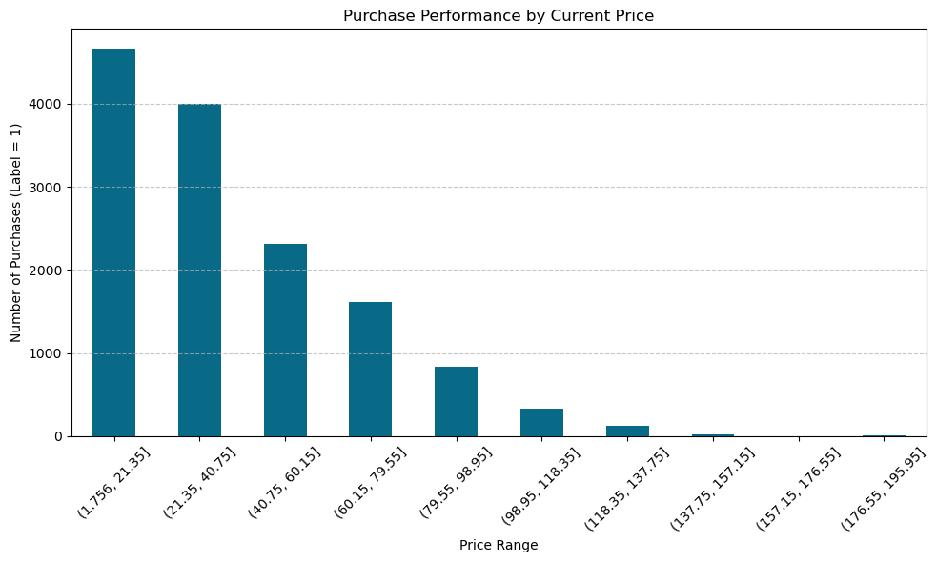
ADVANCED ANALYTICS
- As the discount ratio decreases, indicating an increase in the average current price, there's a corresponding decrease in the number of purchases.

Slide 18
1- Extend the reach of Store Events promotions to other countries like Germany and Austria, leveraging the effectiveness observed in France.
2- Schedule promotions during months with historically lower purchase counts to boost sales during these periods.
3- Initiate seasonal promotions and campaigns in advance, ideally one month before the seasonal period, to maximize their effectiveness.
4- Enhance marketing strategies targeted at men by diversifying our product categories and incorporating main colors that appeal to them.
5- Prioritize Store Event promotions due to their higher success rate, even if they occur less frequently, as they have a positive impact on purchasing decisions.
Solutions

Slide 19
Data Science Process

Slide 20
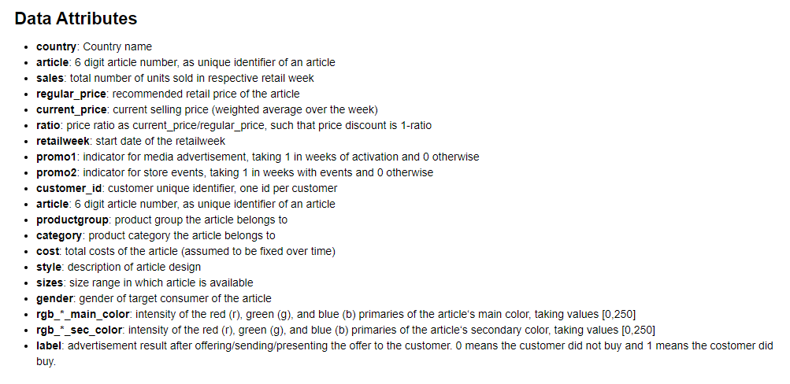
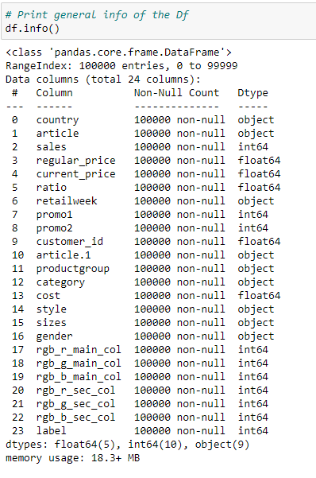
Data Understanding
The Dataset consists of 100000 rows and 24 columns, With no missing values and no duplicates.
The Dataset covers only 3 Countries Germany, France, Austria.
The Dataset covers weekly sales happened from 28 Dec 2014 to 30 April 2017
We are dealing with Dataset since, 13.9% have labels of value 1.

Slide 21
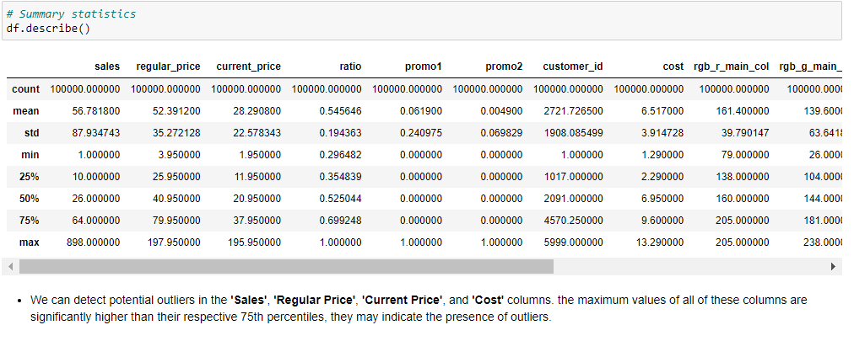

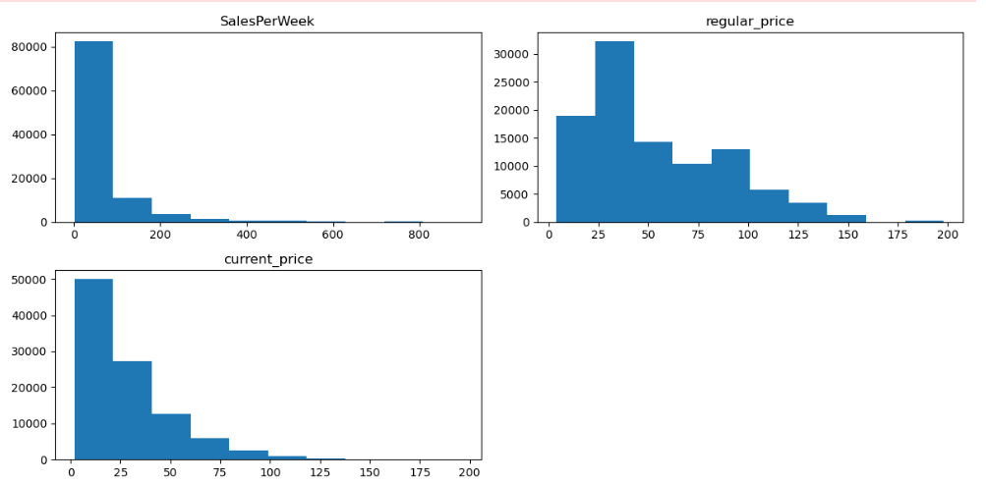
1- Data Cleaning
- Check for outliers
- Check for missing values( No missing values)
Data PREPROCESSING

Slide 22
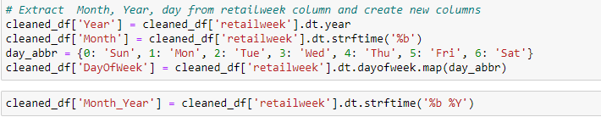
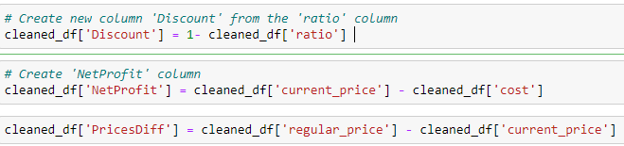
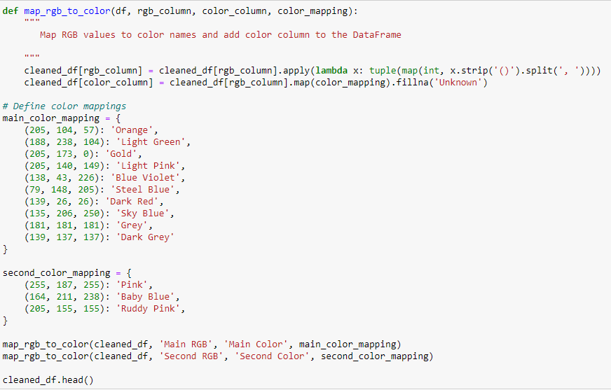
2- Create new features
Data PREPROCESSING

Slide 23
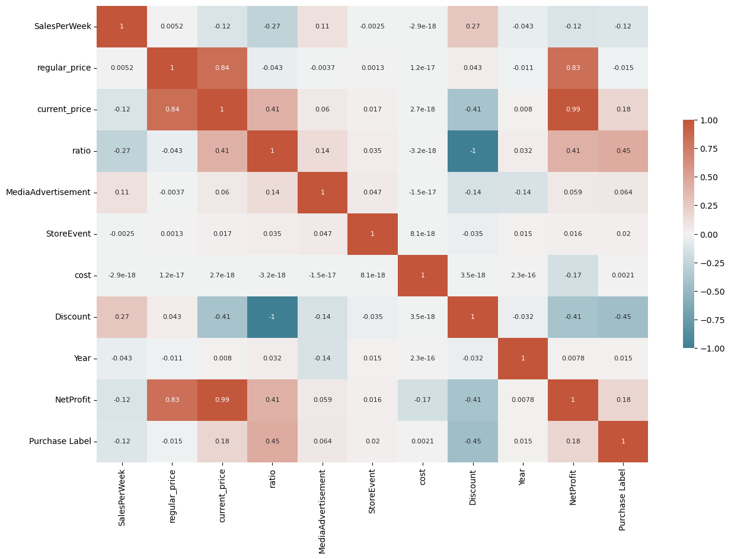
Correlation matrix:-
- salesPerWeak: has a small positive correlation with discount column.
- regular_prices, current_prices and profit columns have a highly positive correlation
- discount has a negative correlation with profit
- discount has a positive correlation with month.
- The label column:
- Has a negative correlation with discount - has a small negative correlation with sales and
a small positive correlation with current_price
EDA

Slide 24
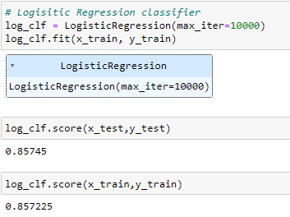
Select and train a certain model
Logistic Regression
- Because the data is not balanced and small number of data and the time constraint I choose the Logistic Regression algorithm to use for this problem to classify potential customer purchase
Model Building
It have 85% confidence to classify future customers and we can collect more data to target more customers that have higher percent for completing a sale

Slide 25
Thank you
By Huda Abd El-Majeed
ALPHA GROUP

